Slide 1

COMP9313: Big Data Management Lecturer: Xin Cao Course web site: http://www.cse.unsw.edu.au/~cs9313/

Slide 2
Chapter 1: Course Information and Introduction to Big Data Management

Slide 3
Part 1: Course Information

Slide 4
Course Info
Lectures： 6：00 – 9:00 pm (Wednesday)
Location:
Ritchie Theatre (K-G19-LG02)
Labs: Weeks 2-13
Consultation (Weeks 1-12): Questions regarding lectures, course materials, assignements, exam, etc.
Time: 3:00 – 4:00 pm (Wednesday)
Place: 201D, K-17
TA:
Xuefeng Chen, xuefeng.chen@student.unsw.edu.au
Tutors: Xuefeng Chen, Kai Wang, Chenji Huang, Yu Hao
Discussion and QA: WebCMS3

Slide 5
Lecturer in Charge
Lecturer: Xin Cao
Office: 201D K17 (outside the lift turn left)
Email: xin.cao@unsw.edu.au
Ext: 55932
Research interests
Database
Data Mining
Big Data Technologies
My homepage: http://www.cse.unsw.edu.au/~z3515164/
My publications list at google scholar: https://scholar.google.com.au/citations?user=kJIkUagAAAAJ&hl=en

Slide 6
Course Aims
This course aims to introduce you to the concepts behind Big Data, the core technologies used in managing large-scale data sets, and a range of technologies for developing solutions to large-scale data analytics problems.
This course is intended for students who want to understand modern large-scale data analytics systems. It covers a wide range of topics and technologies, and will prepare students to be able to build such systems as well as use them efficiently and effectively to address challenges in big data management.
Not possible to cover every aspect of big data management.

Slide 7
Lectures
Lectures focusing on the frontier technologies on big data management and the typical applications
Try to run in more interactive mode and provide more examples
A few lectures may run in more practical manner (e.g., like a lab/demo) to cover the applied aspects
Lecture length varies slightly depending on the progress (of that lecture)
Note: attendance to every lecture is assumed

Slide 8
Resources
Text Books
Hadoop: The Definitive Guide. Tom White. 4th Edition - O'Reilly Media
Mining of Massive Datasets. Jure Leskovec, Anand Rajaraman, Jeff Ullman. 2nd edition - Cambridge University Press
Data-Intensive Text Processing with MapReduce. Jimmy Lin and Chris Dyer. University of Maryland, College Park.
Learning Spark . Matei Zaharia, Holden Karau, Andy Konwinski, Patrick Wendell. O'Reilly Media
Reference Books and other readings
Apache MapReduce Tutorial
Apache Spark Quick Start
Many other online tutorials … …
Big Data is a relatively new topic (so no fixed syllabus)

Slide 9
Prerequisite
Official prerequisite of this course is COMP9024 (Data Structures and Algorithms) and COMP9311 (Database Systems).
Before commencing this course, you should:
have experiences and good knowledge of algorithm design (equivalent to COMP9024 )
have a solid background in database systems (equivalent to COMP9311)
have solid programming skills in Java
be familiar with working on a Unix-style operating systems
have basic knowledge of linear algebra (e.g., vector spaces, matrix multiplication), probability theory and statistics , and graph theory
No previous experience necessary in
MapReduce/Spark
Parallel and distributed programming

Slide 10
Please do not enrol if you
Don’t have COMP9024/9311 knowledge
Cannot produce correct Java program on your own
Never worked on Unix-style operating systems
Have poor time management
Are too busy to attend lectures/labs
Otherwise, you are likely to perform badly in this subject

Slide 11
Learning outcomes
After completing this course, you are expected to:
describe the important characteristics of Big Data
develop an appropriate storage structure for a Big Data repository
utilise the map/reduce paradigm and the Spark platform to manipulate Big Data
use a high-level query language to manipulate Big Data
develop efficient solutions for analytical problems involving Big Data

Slide 12
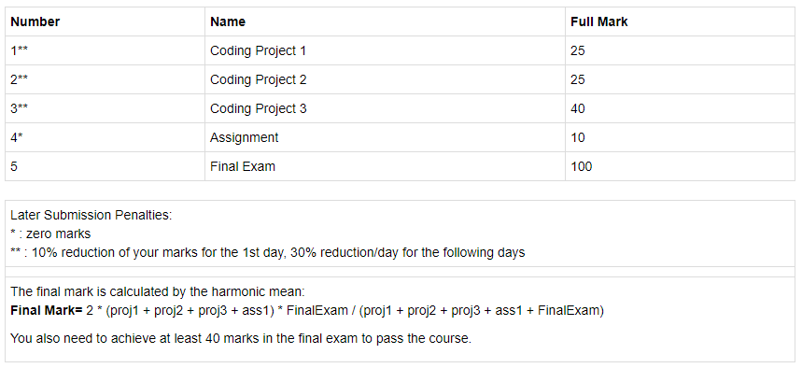
Assessment

Slide 13
Projects and Assignment
Projects:
1 project on Hadoop MapReduce
1 project on Spark
1 project on AWS (MapReduce/Spark)
Assignment: previous years exam questions
Both results and source codes will be checked.
If not able to run your codes due to some bugs, you will not lose all marks.

Slide 14
CSE Computing Environment
Use Linux/command line (virtual machine image will be provided)
Projects marked on Linux servers
You need to be able to upload, run, and test your program under Linux
Assignment submission
Use Give to submit (either command line or web page)
Classrun. Check your submission, marks, etc. Read https://wiki.cse.unsw.edu.au/give/Classrun

Slide 15
Final exam
Final written exam (100 pts)
If you are ill on the day of the exam, do not attend the exam – I will not accept any medical special consideration claims from people who already attempted the exam
You need to achieve at least 40 marks in the final exam
No supplementary exam will be given

Slide 16
You May Fail Because …
*Plagiarism*
Code failed to compile due to some mistakes
Late submission
1 sec late = 1 day late
submit wrong files
Program did not follow the spec
I am unlikely to accept the following excuses:
“Too busy”
“It took longer than I thought it would take”
“It was harder than I initially thought”
… …

Slide 17
Tentative Course Schedule
Week | Topic | Assignment
1 | Course info and introduction to big data
2 | Hadoop MapReduce 1
3 | Hadoop MapReduce 2 | Proj1
4 | Hadoop MapReduce 3
5 | Spark 1
6 | Spark 2 | Proj2
7 | Spark 3
8 | Finding Similar Items | Proj3
9 | Data stream mining
10 | Recommender Systems
11 | NoSQL and High Level MapReduce Tools | Ass1
12 | Revision and exam preparation

Slide 18
Labs
4 labs on MapReduce
4 labs on Spark
1 lab on high level MapReduce tools
1 lab on AWS
1 lab on big data machine learning platform [tentative]

Slide 19
Virtual Machine
Software: Virtualbox
Images:
Pure Xubuntu 14.04: http://www.cse.unsw.edu.au/~z3515164/Raw_Xubuntu.zip
Xubuntu 14.04 with pre-installed Hadoop and Eclipse plugin: http://mirror.cse.unsw.edu.au/pub/cs9313/Xubuntu.zip
Download the zip file and uncompress it, and rename the file "xubuntu-disk.vmdk" as "xubuntu-disk2.vmdk“
Open VirtualBox, File->Import Applicance
Browse the image folder, select the "*.ovf" file
The image will be imported to your computer, which may take 10 minutes
comp9313 is used as both username and password. The hadoop installation path is the same as in the virtual machine on lab computers.

Slide 20
Your Feedbacks Are Important
Big data is a new topic, and thus the course is tentative
The technologies keep evolving, and the course materials need to be updated correspondingly
Please advise where I can improve after each lecturer, at the discussion and QA website
myExperience system

Slide 21
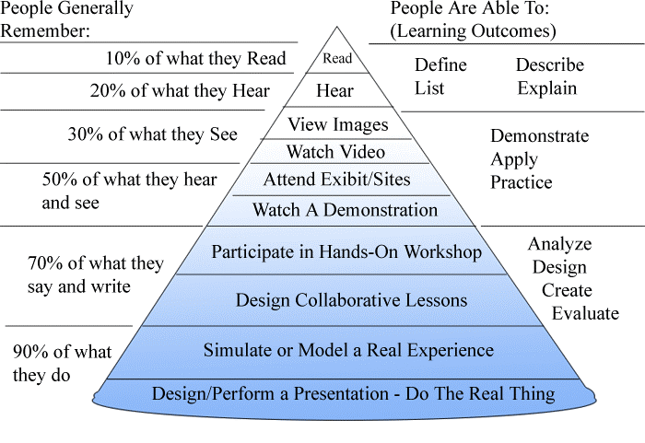
Why Attend the Lectures?

Slide 22
Part 2: Introduction to Big Data

Slide 23
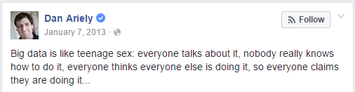
What is Big Data?
No standard definition! here is from Wikipedia:
Big data is a term for data sets that are so big and complex that traditional data processing application software are inadequate to deal with them
Challenges include capturing data, data storage, data analysis, search, sharing, transfer, visualization, querying, updating, information privacy and data source.
The term "big data" often refers simply to the use of predictive analytics, user behaviour analytics, or certain other advanced data analytics methods that extract value from data, and seldom to a particular size of data set

Slide 24
Instead of Talking about “Big Data”…
Let’s talk about a crowded application ecosystem:
Hadoop MapReduce
Spark
NoSQL (e.g., HBase, MongoDB, Neo4j)
Pregel
… …
Let’s talk about data science and data management:
Finding similar items
Graph data processing
Streaming data processing
Machine learning technologies
… …

Slide 25


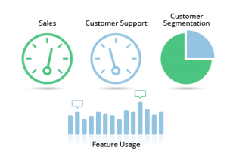








Who is generating Big Data?
Social
User Tracking & Engagement
Homeland Security
eCommerce
Financial Services
Real Time Search

Slide 26
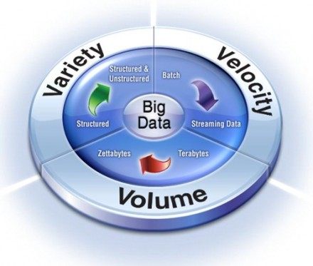

Big Data Characteristics: 3V
Notes:
Enterprise resource planning
Customer relationship management

Slide 27
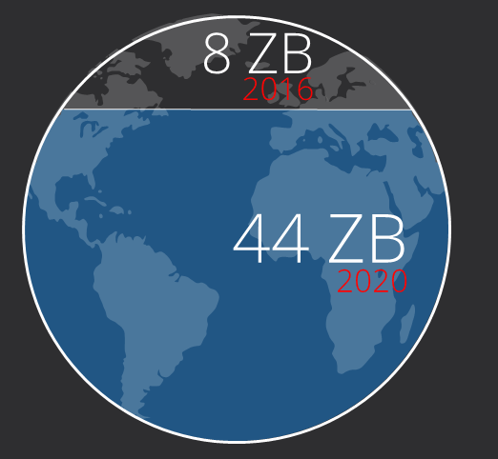

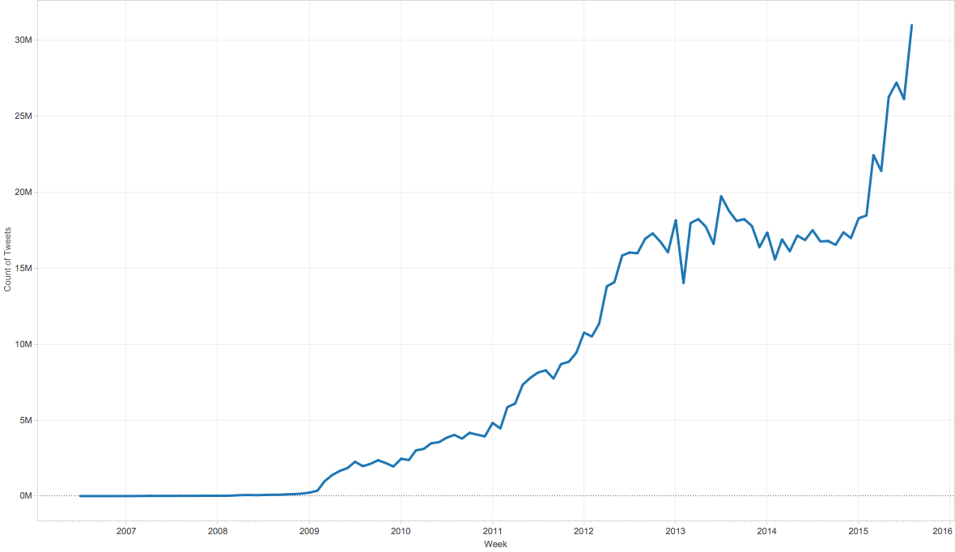
Volume (Scale)
Data Volume
Growth 40% per year
From 8 zettabytes (2016) to 44zb (2020)
Data volume is increasing exponentially
Number of Tweets

Slide 28
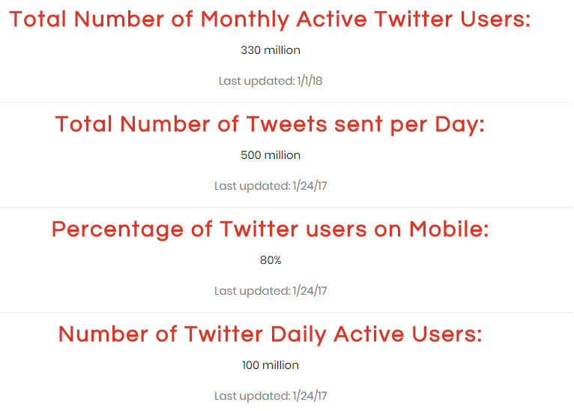
Recent Twitter Statistics

Slide 29
Variety (Complexity)
Different Types:
Relational Data (Tables/Transaction/Legacy Data)
Text Data (Web)
Semi-structured Data (XML)
Graph Data
Social Network, Semantic Web (RDF), …
Streaming Data
You can only scan the data once
A single application can be generating/collecting many types of data
Different Sources：
Movie reviews from IMDB and Rotten Tomatoes
Product reviews from different provider websites
To extract knowledge➔ all these types of data need to linked together

Slide 30
















A Single View to the Customer
Social Media
Banking
Finance
Gaming
Our
Known
History
Customer
Entertain
Purchase

Slide 31










A Global View of Linked Big Data
Diversified social network

Slide 32
Velocity (Speed)
Data is being generated fast and need to be processed fast
Online Data Analytics
Late decisions ➔ missing opportunities
Examples
E-Promotions: Based on your current location, your purchase history, what you like ➔ send promotions right now for store next to you
Healthcare monitoring: sensors monitoring your activities and body ➔ any abnormal measurements require immediate reaction
Disaster management and response

Slide 33
Velocity in Real-world
Every second, on average, around 6,000 tweets are tweeted on Twitter (visualize them here), which corresponds to over 350,000 tweets sent per minute, 500 million tweets per day and around 200 billion tweets per year.
The statistics for 1 second in many applications. http://www.internetlivestats.com/one-second/

Slide 34
Extended Big Data Characteristics: 6V
Volume: In a big data environment, the amounts of data collected and processed are much larger than those stored in typical relational databases.
Variety: Big data consists of a rich variety of data types.
Velocity: Big data arrives to the organization at high speeds and from multiple sources simultaneously.
Veracity: Data quality issues are particularly challenging in a big data context.
Visibility/Visualization: After big data being processed, we need a way of presenting the data in a manner that’s readable and accessible.
Value: Ultimately, big data is meaningless if it does not provide value toward some meaningful goal.

Slide 35
Veracity (Quality & Trust)
Data = quantity + quality
When we talk about big data, we typically mean its quantity:
What capacity of a system provides to cope with the sheer size of the data?
Is a query feasible on big data within our available resources?
How can we make our queries tractable on big data?
. . .
Can we trust the answers to our queries?
Dirty data routinely lead to misleading financial reports, strategic business planning decision ⇒ loss of revenue, credibility and customers, disastrous consequences
The study of data quality is as important as data quantity

Slide 36
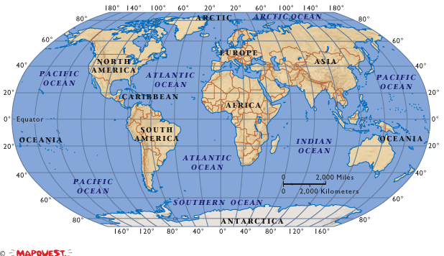
Data in real-life is often dirty
81 million National Insurance numbers but only 60 million eligible citizens
98000 deaths each year, caused by errors in medical data
500,000 dead people retain active Medicare cards

Slide 37
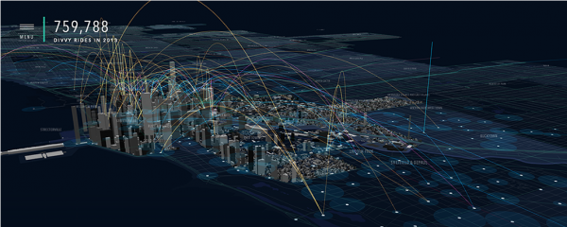

Visibility/Visualization
Visibility: the state of being able to see or be seen is implied.
Big Data – visibility = Black Hole?
Visualization: Making all that vast amount of data comprehensible in a manner that is easy to understand and read.
Big data visualization tools:
A visualization of Divvy bike rides across Chicago

Slide 38

Value
Big data is meaningless if it does not provide value toward some meaningful goal

Slide 39
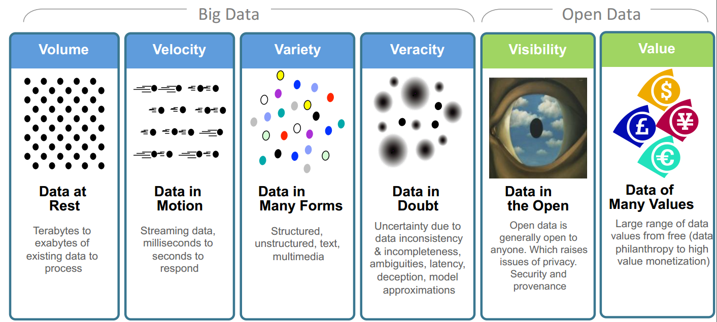
Big Data: 6V in Summary
Transforming Energy and Utilities through Big Data & Analytics. By Anders Quitzau@IBM

Slide 40
Other V’s
Variability
Variability refers to data whose meaning is constantly changing. This is particularly the case when gathering data relies on language processing.
Viscosity
This term is sometimes used to describe the latency or lag time in the data relative to the event being described. We found that this is just as easily understood as an element of Velocity.
Volatility
Big data volatility refers to how long is data valid and how long should it be stored. You need to determine at what point is data no longer relevant to the current analysis.
More V’s in the future …
How many v’s are there in big data? http://www.clc-ent.com/TBDE/Docs/vs.pdf

Slide 41
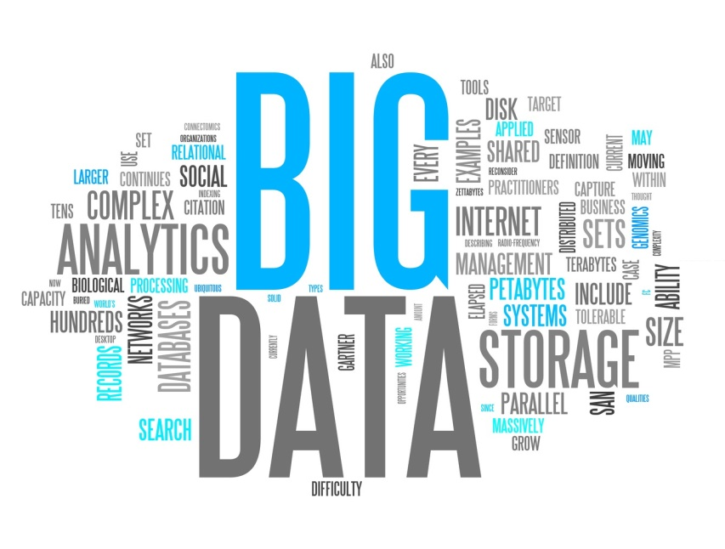

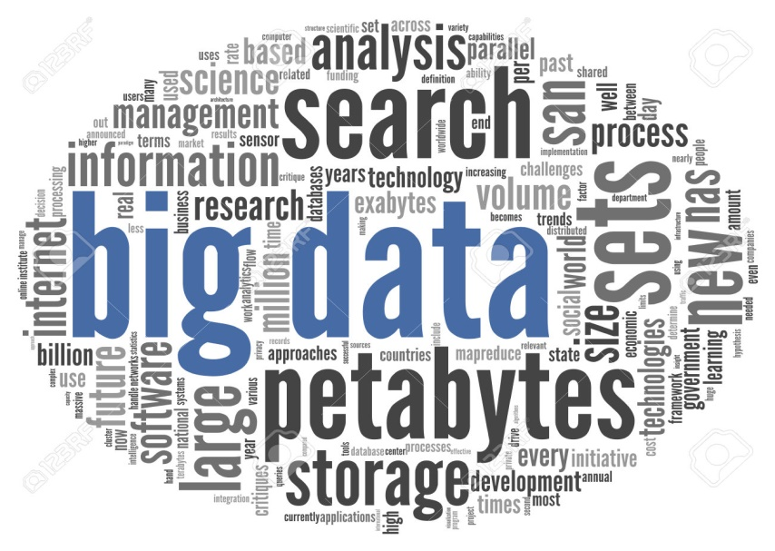
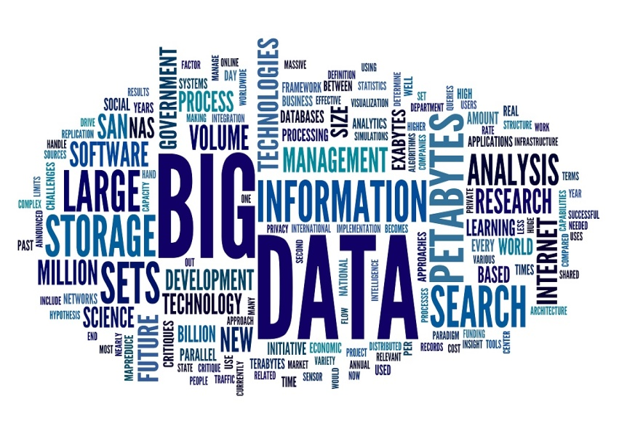
Tag Clouds of Big Data

Slide 42
Why Study Big Data Technologies?
The hottest topic in both research and industry
Highly demanded in real world
A promising future career
Research and development of big data systems:
distributed systems (eg, Hadoop), visualization tools, data warehouse, OLAP, data integration, data quality control, …
Big data applications:
social marketing, healthcare, …
Data analysis: to get values out of big data
discovering and applying patterns, predicative analysis, business intelligence, privacy and security, …
Get enough credits

Slide 43
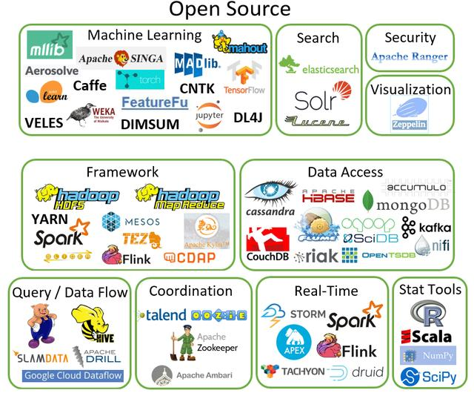
Big Data Open Source Tools

Slide 44
What will the course cover
Topic 1. Big data management tools
Apache Hadoop
MapReduce
YARN/HDFS/HBase/Hive/Pig (briefly introduced)
Spark
AWS platform
Mahout/MLlib [tentative]
Topic 2. Big data typical applications
Finding similar items
Graph data processing
Data stream mining
Recommender Systems

Slide 45

Distributed processing is non-trivial
How to assign tasks to different workers in an efficient way?
What happens if tasks fail?
How do workers exchange results?
How to synchronize distributed tasks allocated to different workers?

Slide 46

Big data storage is challenging
Data Volumes are massive
Reliability of Storing PBs of data is challenging
All kinds of failures: Disk/Hardware/Network Failures
Probability of failures simply increase with the number of machines …

Slide 47


What is Hadoop
Open-source data storage and processing platform
Before the advent of Hadoop, storage and processing of big data was a big challenge
Massively scalable, automatically parallelizable
Based on work from Google
Google: GFS + MapReduce + BigTable (Not open)
Hadoop: HDFS + Hadoop MapReduce + HBase（opensource)
Named by Doug Cutting in 2006 (worked at Yahoo! at that time), after his son's toy elephant.

Slide 48


Hadoop offers
Redundant, Fault-tolerant data storage
Parallel computation framework
Job coordination
Q: Where file is located?
No longer need to worry about
Q: How to handle failures & data lost?
Q: How to divide computation?
Programmers
Q: How to program for scaling?

Slide 49
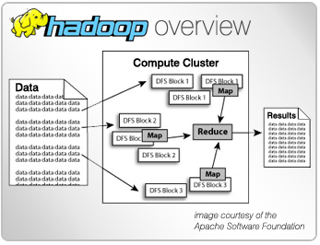
Why Use Hadoop?
Cheaper
Scales to Petabytes or more easily
Faster
Parallel data processing
Better
Suited for particular types of big data problems

Slide 50
















Companies Using Hadoop

Slide 51
Hadoop is a set of Apache Frameworks and more…
Data storage (HDFS)
Runs on commodity hardware (usually Linux)
Horizontally scalable
Processing (MapReduce)
Parallelized (scalable) processing
Fault Tolerant
Other Tools / Frameworks
Data Access
HBase, Hive, Pig, Mahout
Tools
Hue, Sqoop
Monitoring
Greenplum, Cloudera
Monitoring & Alerting
Tools & Libraries
Data Access
MapReduce API
Hadoop Core - HDFS

Slide 52
What are the core parts of a Hadoop distribution?
HDFS Storage
MapReduce API
Redundant (3 copies)
For large files – large blocks
64 or 128 MB / block
Can scale to 1000s of nodes
Other Libraries
Batch (Job) processing
Distributed and Localized to clusters (Map)
Auto-Parallelizable for huge amounts of data
Fault-tolerant (auto retries)
Adds high availability and more
Pig
Hive
HBase
Others

Slide 53
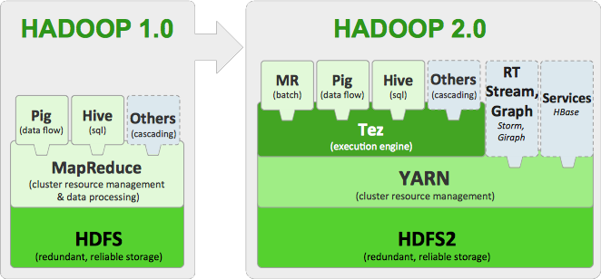
Hadoop 2.0
Single Use System
Batch apps
Multi-Purpose Platform
Batch, Interactive, Online, Streaming
Hadoop YARN (Yet Another Resource Negotiator): a resource-management platform responsible for managing computing resources in clusters and using them for scheduling of users' applications

Slide 54
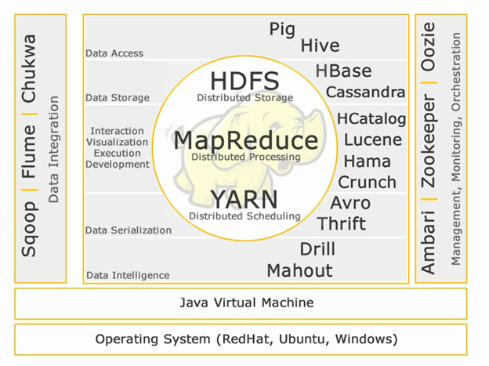
Hadoop Ecosystem
A combination of technologies which have proficient advantage in solving business problems.
http://www.edupristine.com/blog/hadoop-ecosystem-and-components

Slide 55
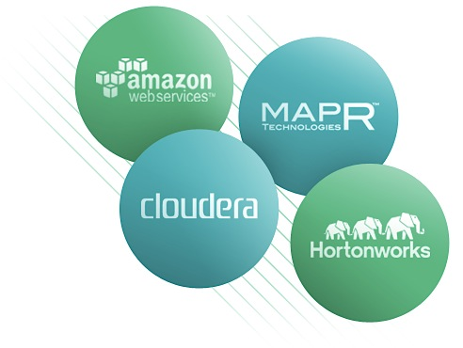

Common Hadoop Distributions
Open Source
Apache
Commercial
Cloudera
Hortonworks
MapR
AWS MapReduce
Microsoft Azure HDInsight (Beta)

Slide 56

Setting up Hadoop Development
Hadoop Binaries
Data Storage
MapReduce
Other Libraries & Tools
Local install
Linux
Windows
Local
File System
HDFS Pseudo-distributed (single-node)
Local
Vendor Tools
Cloudera’s Demo VM
Need Virtualization software, i.e. VMware, etc…
Cloud
AWS
Azure
Others
Cloud
Libraries
Cloud
AWS
Microsoft (Beta)
Others

Slide 57
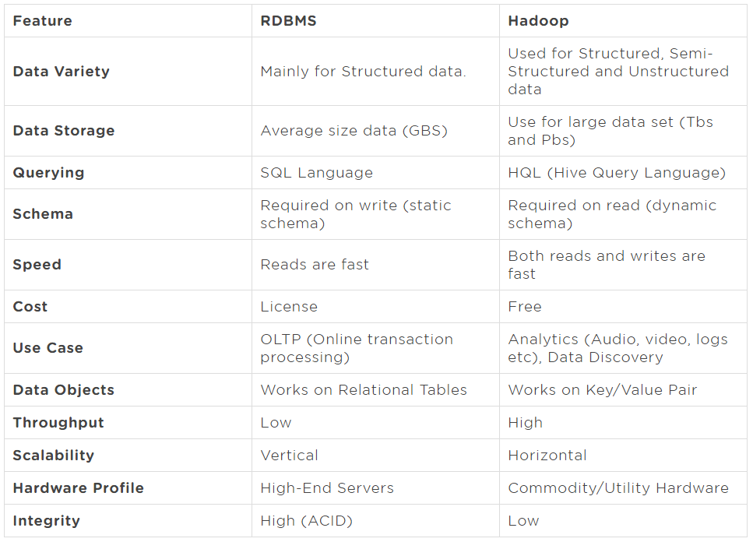


Comparing: RDBMS vs. Hadoop
Notes:
Atomicity, Consistency, Isolation, Durability

Slide 58
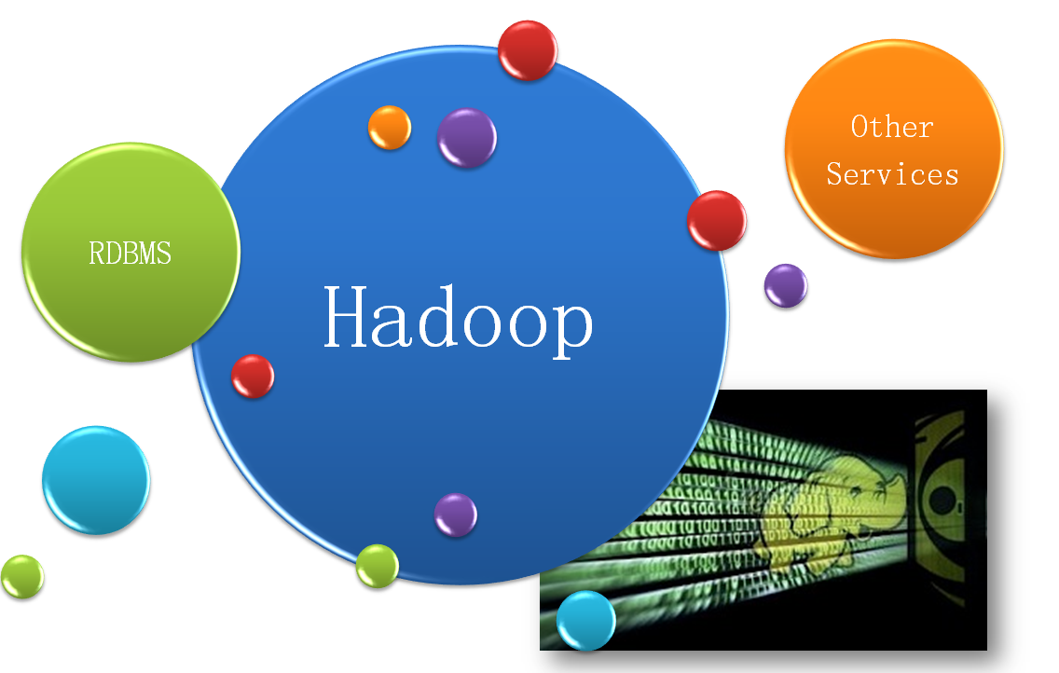
The Changing Data Management Landscape

Slide 59
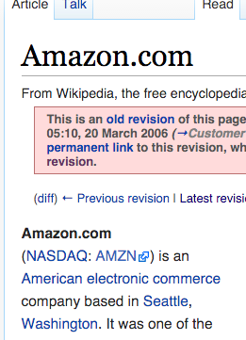
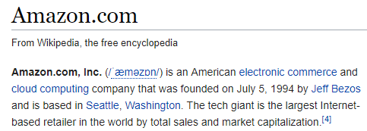
AWS (Amazon Web Services)
Amazon
From Wikipedia 2006
From Wikipedia 2017

Slide 60
AWS (Amazon Web Services)
AWS is a subsidiary of Amazon.com, which offers a suite of cloud computing services that make up an on-demand computing platform.
Amazon Web Services (AWS) provides a number of different services, including:
Amazon Elastic Compute Cloud (EC2) Virtual machines for running custom software
Amazon Simple Storage Service (S3) Simple key-value store, accessible as a web service
Amazon Elastic MapReduce (EMR) Scalable MapReduce computation
Amazon DynamoDB Distributed NoSQL database, one of several in AWS
Amazon SimpleDB Simple NoSQL database
...

Slide 61
Cloud Computing Services in AWS
IaaS
EC2, S3, …
Highlight: EC2 and S3 are two of the earliest products in AWS
PaaS
Aurora, Redshift, …
Highlight: Aurora and Redshift are two of the fastest growing products in AWS
SaaS
WorkDocs, WorkMail
Highlight: May not be the main focus of AWS

Slide 62
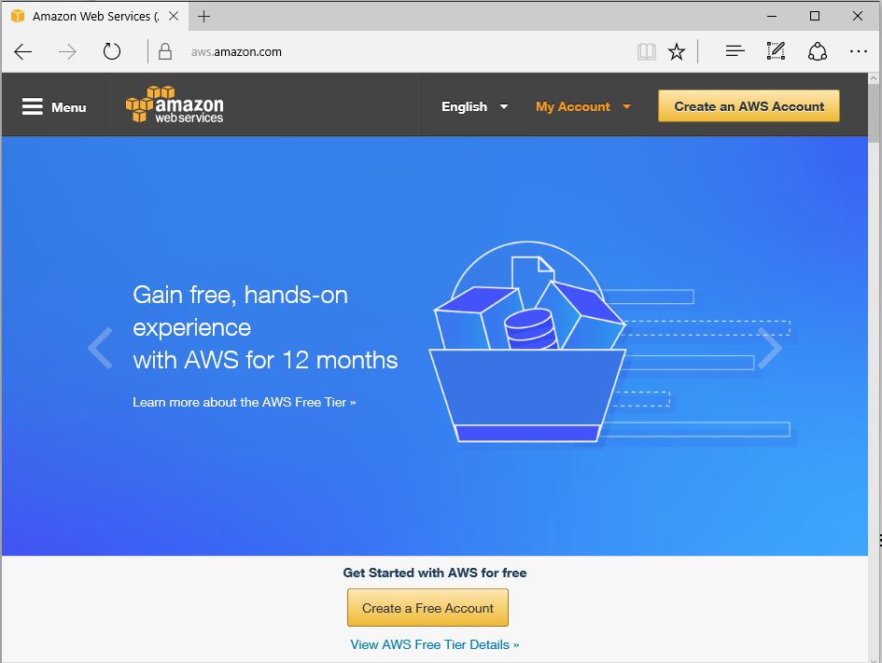
Setting up an AWS account
aws.amazon.com
Sign up for an account on aws.amazon.com
You need to choose an username and a password
These are for the management interface only
Your programs will use other credentials (RSA keypairs, access keys, ...) to interact with AWS

Slide 63
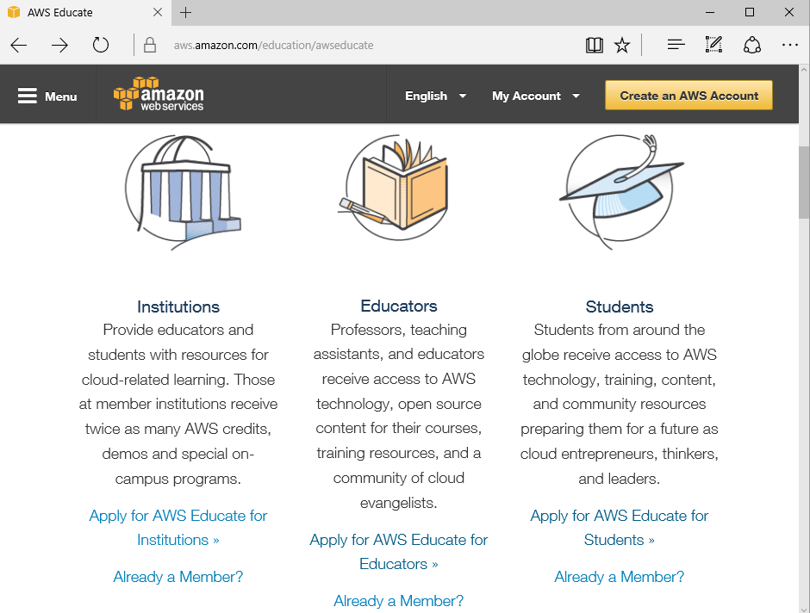
Signing up for AWS Educate
Complete the web form on https://aws.amazon.com/education/awseducate/
Assumes you already have an AWS account
Use your UNSW email address!
Amazon says it should only take 2-5 minutes (but don’t rely on this!!)
This should give you $100/year in AWS credits. Be careful!!!

Slide 64
Part 2: Introduction to MapReduce

Slide 65
What is MapReduce
Origin from Google, [OSDI’04]
MapReduce: Simplified Data Processing on Large Clusters
Jeffrey Dean and Sanjay Ghemawat
Programming model for parallel data processing
Hadoop can run MapReduce programs written in various languages: e.g. Java, Ruby, Python, C++
For large-scale data processing
Exploits large set of commodity computers
Executes process in distributed manner
Offers high availability

Slide 66
Motivation for MapReduce
Typical big data problem challenges:
How do we break up a large problem into smaller tasks that can be executed in parallel?
How do we assign tasks to workers distributed across a potentially large number of machines?
How do we ensure that the workers get the data they need?
How do we coordinate synchronization among the different workers?
How do we share partial results from one worker that is needed by another?
How do we accomplish all of the above in the face of software errors and hardware faults?

Slide 67
Motivation for MapReduce
There was need for an abstraction that hides many system-level details from the programmer.
MapReduce addresses this challenge by providing a simple abstraction for the developer, transparently handling most of the details behind the scenes in a scalable, robust, and efficient manner.
MapReduce separates the what from the how

Slide 68
Typical Big Data Problem
Iterate over a large number of records
Extract something of interest from each
Shuffle and sort intermediate results
Aggregate intermediate results
Generate final output
Map
Reduce
Key idea: provide a functional abstraction for these two operations

Slide 69


The Idea of MapReduce
Inspired by the map and reduce functions in functional programming
We can view map as a transformation over a dataset
This transformation is specified by the function f
Each functional application happens in isolation
The application of f to each element of a dataset can be parallelized in a straightforward manner
We can view reduce as an aggregation operation
The aggregation is defined by the function g
Data locality: elements in the list must be “brought together”
If we can group elements of the list, also the reduce phase can proceed in parallel
The framework coordinates the map and reduce phases:
Grouping intermediate results happens in parallel

Slide 70
Everything Else?
Handles scheduling
Assigns workers to map and reduce tasks
Handles “data distribution”
Moves processes to data
Handles synchronization
Gathers, sorts, and shuffles intermediate data
Handles errors and faults
Detects worker failures and restarts
Everything happens on top of a distributed file system (HDFS)
You don’t know:
Where mappers and reducers run
When a mapper or reducer begins or finishes
Which input a particular mapper is processing
Which intermediate key a particular reducer is processing

Slide 71
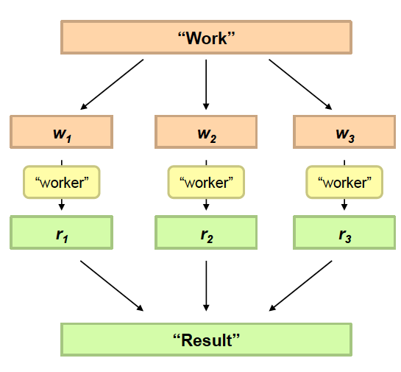
Philosophy to Scale for Big Data Processing
Divide Work
Combine Results

Slide 72
Distributed Word Count
Huge Document
Block1
Block2
Block3
Block4
…
Comptuer1
Comptuer2
Comptuer3
Comptuer4
…
Merge
Partial Count1
Partial Count2
Partial Count3
Partial Count4
…
Final Result

Slide 73
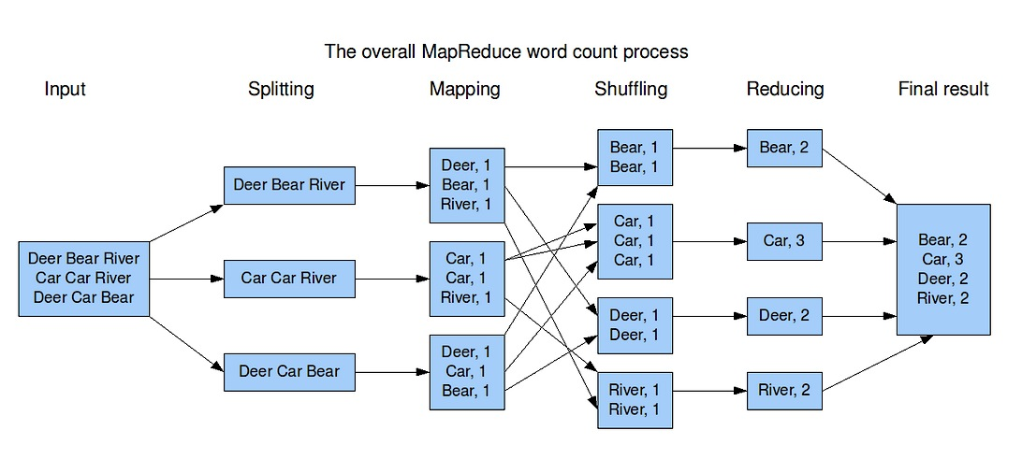
MapReduce Example - WordCount
Hadoop MapReduce is an implementation of MapReduce
MapReduce is a computing paradigm (Google)
Hadoop MapReduce is an open-source software

Slide 74
End of Chapter 1

